Slide 1

BOOK
Recommendation
SYSTEM
ARTIFICIAL INTELLIGENCE PORTFOLIO

Slide 2
USER’S BOOK INTERESTS
introduction
Recommends books for a user
Need data about the user including which book he/she already likes
System uses this info and a dataset which contains info about various books and users
BOOKS DATA
RECOMMENDATION SYSTEM
USERS DATA
RECOMMENDED BOOKS WHICH USER MIGHT LIKE

Slide 3
?
Problem statement
We have to build a recommendation system which will recommend books for a user based on his/her already liked books.

Slide 4
1
FINDING DATA

Slide 5

UCSD BOOK GRAPH
Data collected in late 2017 from goodreads.com
Three groups of datasets:
Meta-data of the books
User-book interactions (ratings)
Users' detailed book reviews

Slide 6
goodreads_books.json.gz
goodreads_interactions.csv
goodread_reviews_dedup.json.gz
BOOKS
METADATA
USER
INTERACTIONS
USER
REVIEWS
2.36 Million Books
~2 GB
229 Million User Ratings
~4 GB
15.7 Millions User Reviews
~5 GB

Slide 7
2
LOADING DATA
AND
LOOKING AT DATA

Slide 8
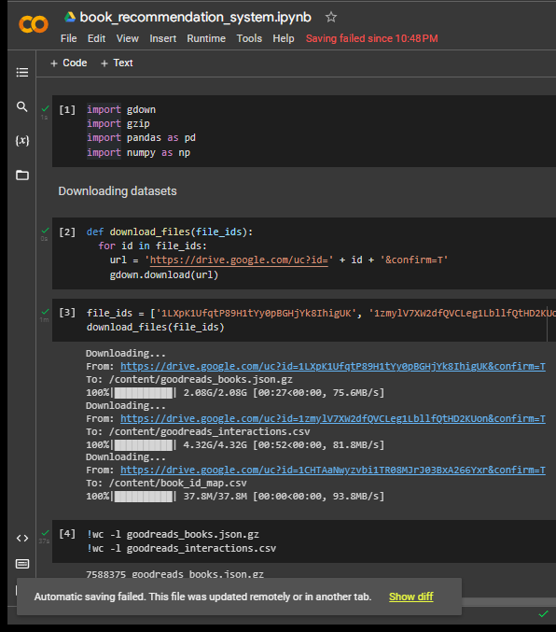
CHALLENGES
With dataset
Very large datasets
Require more processing and large memory
Difficult to process on local machines
Hence, we used Google Collab
Google Collaboratory – Online platform for writing and running python notebooks

Slide 9
Books Data contents
{
"isbn":"0312853122",
"text_reviews_count":"1",
"series":[
],
"country_code":"US",
"language_code":"",
"popular_shelves":[
{
"count":"3",
"name":"to-read"
},
{
"count":"1",
"name":"p"
},
{
"count":"1",
"name":"collection"
},
{
"count":"1",
"name":"w-c-fields"
},
{
"count":"1",
"name":"biography"
}
],
"asin":"",
"is_ebook":"false",
"average_rating":"4.00",
"kindle_asin":"",
"similar_books":[
],
"description":"",
"format":"Paperback", "link":"https://www.goodreads.com/book/show/5333265-w-c-fields",
"authors":[
{
"author_id":"604031",
"role":""
}
], ":"1984
"publisher":"St. Martin's Press",
"num_pages":"256",
"publication_day":"1",
"isbn13":"9780312853129",
"publication_month":"9",
"edition_information":"",
"publication_year",
"url":"https://www.goodreads.com/book/show/5333265-w-c-fields",
"image_url":"https://images.gr-assets.com/books/1310220028m/5333265.jpg",
"book_id":"5333265",
"ratings_count":"3",
"work_id":"5400751",
"title":"W.C. Fields: A Life on Film",
"title_without_series":"W.C. Fields: A Life on Film"
}

Slide 10
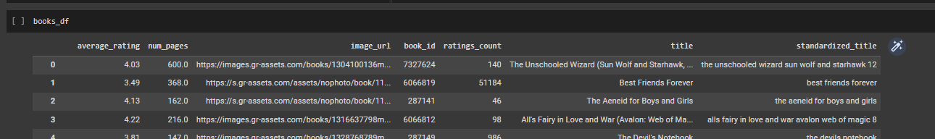
2.36 Million Books ------------- shortage of memory
Cannot load whole file into memory
Read data line by line and keep only useful data
Many useless books
Only those books were considered which where rated by 20 or more users.
Lots of irrelevant fields
Only relevant fields were kept
All this stored in a Pandas Data frame
Title was standardized so that searching could be easy
All characters converted to lowercase
Non-AlphaNum characters removed

Slide 11
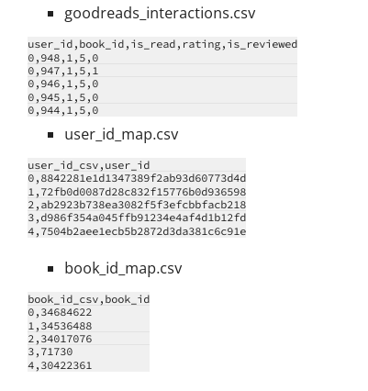
RATINGS Data contents
We don’t need all user ratings in memory as it can cause high memory usage
We read these files accordingly in different models.
We only need ratings given by users similar to us. Hence, we will get those ratings when needed.
We will read these files in line by line fashion too.

Slide 12
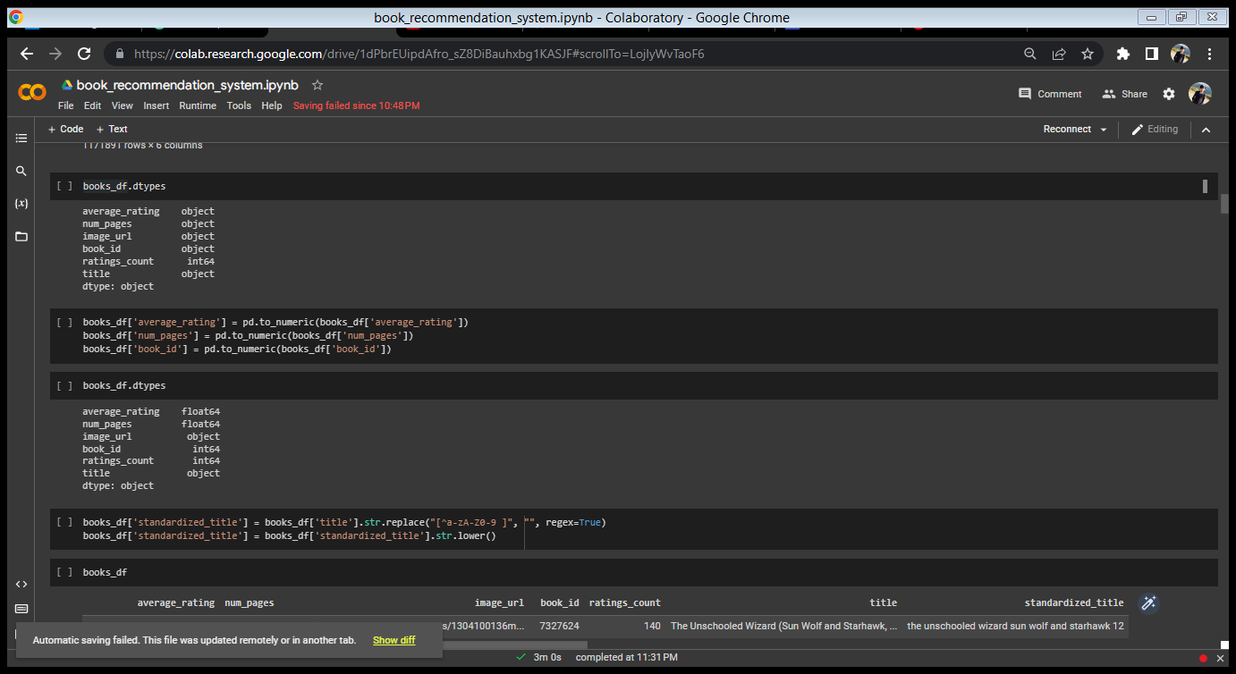

ENFORCING DATA TYPES in book data

Slide 13
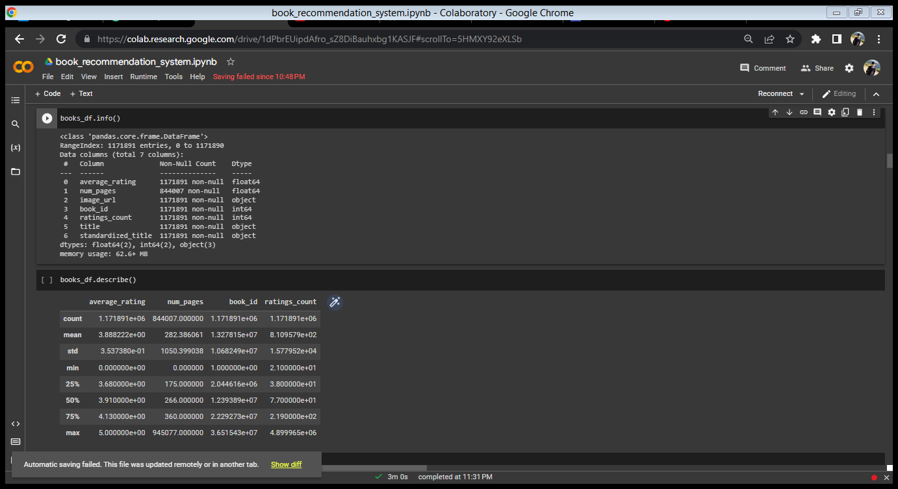
OBSERVING book DATA ANALYTICALLY

Slide 14
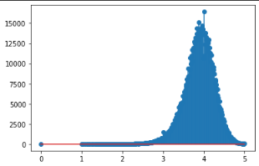
OBSERVING average RATINGS GRAPHICALLY
BOOK COUNT ->
AVERAGE RATINGS ->

Slide 15
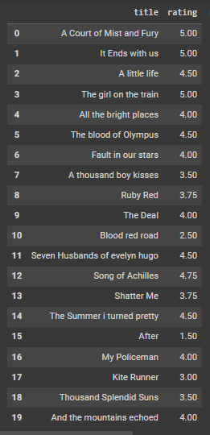
Input user data For recommendation

Slide 16
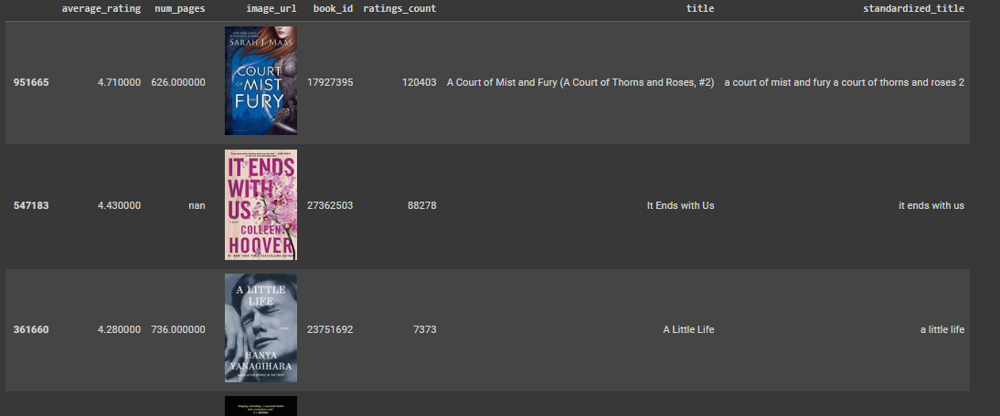
Input Book titles were searched in dataset using TF-IDF vector
Corresponding records in dataset were found

Slide 17
3
CREATING
RECOMMENDATION
MODELS

Slide 18
MODEL1
POPULARITY BASED model
HOW TO FIND WHICH BOOK IS MORE POPULAR??
We’ll use a custom popularity score
Popularity dependent on Number of ratings and average rating
Score = Rating Count * Average Rating
Find the most popular books and recommend them

Slide 19
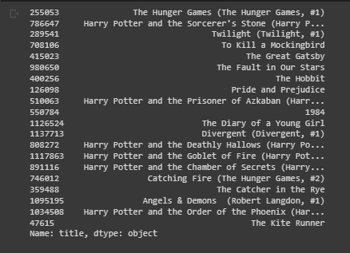
Recommendation based on popularity

Slide 20
Limitations of popularity model
Books are not recommended according to our interests
We may not like some of popular books
Recommendations are not specific to user

Slide 21
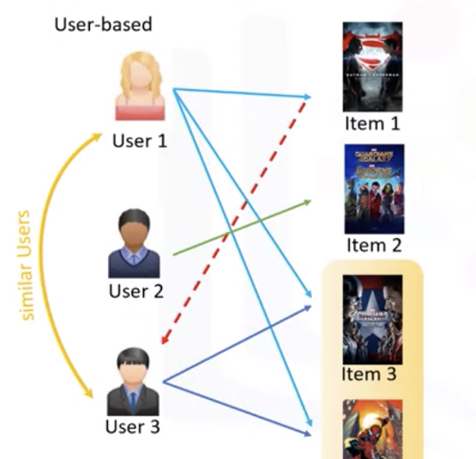
MODEL2
Collaborative filtering BASED model
Finding users who liked the same books as us
And recommend the books that they have liked but we haven’t read

Slide 22
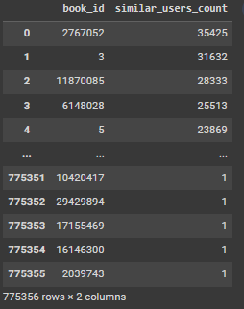
Collaborative filtering BASED model
Find users who liked the same books as us
Find books that these similar user rated high (in other words liked)
Among these books recommend those books which were liked by most among similar users

Slide 23
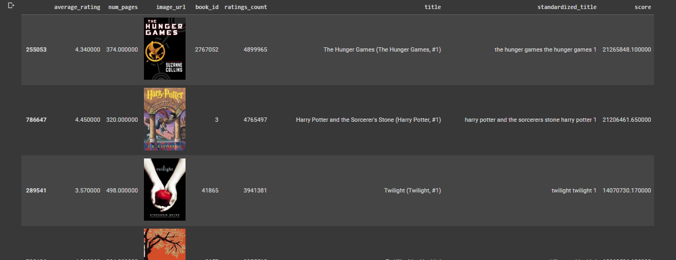
Recommendation based on similar users
Limitation : Some of the recommended books are popular books. We might want recommendations which are not much popular overall but popular within users similar to us. That way the recommendations will be more tailored.

Slide 24
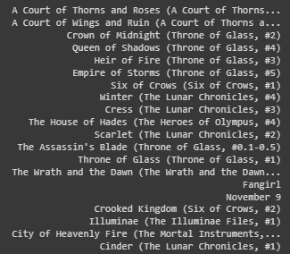
We used score to sort recommendations
Similar Users Count = Number of users similar to us who liked the book
Score = Similar Users Count * (Similar Users Count / Total ratings count)
Sort according to score and recommend
Those books will be recommended first which are popular among users similar to us but not so popular overall

Slide 25
MODEL3
Collaborative filtering BASED model 2
Finding users whose rated books just like us
Also considers books we might have disliked
And recommend the books that similar users rated high

Slide 26
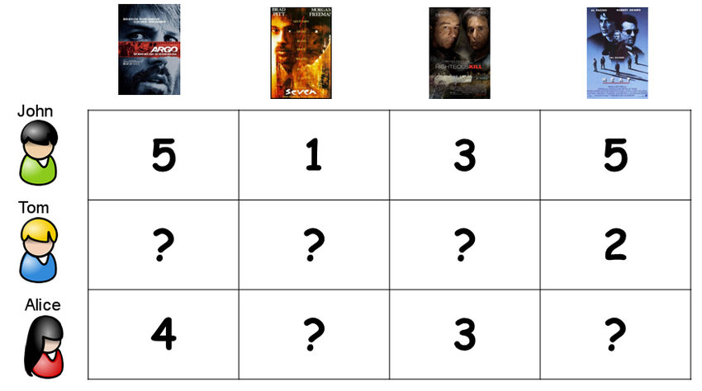
Collaborative filtering BASED model 2
Create a user ratings matrix.
Rows represent users and columns represent books
A cell (i, j) represent rating given by user i to book j
In a similar way, a vector(1-D matrix) for our ratings was created
Our ratings vector was checked for similarity with all rows of matrix
Recommend books based on users whose rating vector was most similar to us
Done using sparse matrix as size could grow very large!!!
Done using cosine similarity!!!

Slide 27
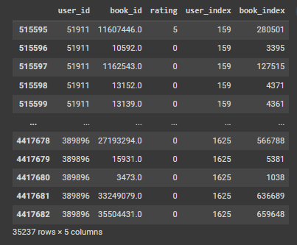
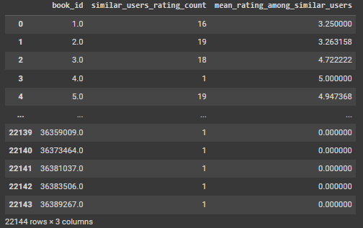
1
Find users whose rating vector is similar to us
2
3
Find the ratings given by those users
Extract all books a long with how many times they occurred
and their mean rating

Slide 28
We used score to sort recommendations
4
Score = (Mean rating among similar users) * (Number of similar users who rated the book)
Sort the recommended books according to this score

Slide 29
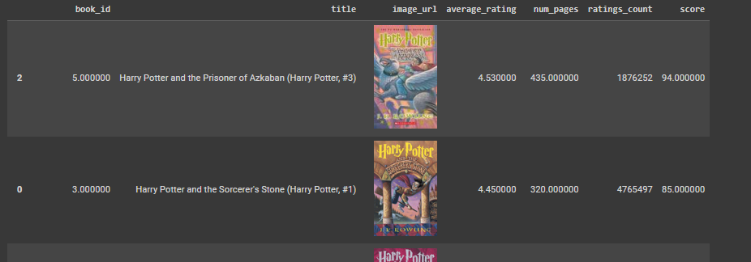
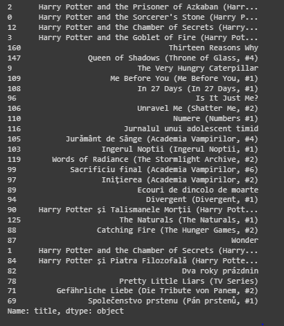
RESULT

Slide 30
4
CONCLUSIONS
MODEL 1
BASIC MODEL
RECOMMENDED SOLELY ON POPULARITY
NOT SO GOOD!
MODEL 2
GOOD ENOUGH WHEN WE NEEDED RECOMMENDATIONS POPULAR AMONG OUR TASTE BUT NOT SO POPULAR OVERALL
DID NOT CONSIDER THE BOOKS THAT WE DISLIKED
MODEL 3
GAVE BEST RECOMMENDATIONS
CONSIDERED ALL OF OUR RATING INCLUDING OUR DISLIKES
MATCHED OUR RATINGS WITH OTHER USERS RATINGS
FINDED THE MOST SIMILAR USERS TO RECOMMEND BOOKS THAT THEY LIKED

Slide 31
5
FUTURE PROSPECTS

Slide 32
FUTURE PROSPECTS
Add a new recommendation model based on genres
Build a web front-end for the recommendation system
Users will enter their interest and the recommendations will be displayed on the webpage
Build Backend using Django framework in python and use this model in the backend
Obviously need high memory server so that time taken to build recommendations is short
Need to load entire dataset into memory

Slide 33



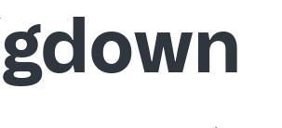




TECH STACK
LIBRARIES USED

Slide 34
THANK YOU!!
MADE BY :
AYUSH DAS
ARYAN
SUJYOTI
ISHITA
NITIN
SHIVANI

